Slide 1
What to expect. . .
GA Freight Depot
February 27, 2025

Slide 2
Agenda
 | What is Substance Use Prevention Day?
 | Tips For a Successful Visit
 | Logistics
 | Questions & Answers

Slide 3
Substance use prevention day 2025
An opportunity for preventionist, coalition members, community stakeholders, and youth, to gather at the Capitol to raise awareness of substance use prevention and advocate on behalf of our communities and our state.

Slide 4
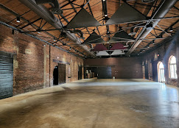
February 27, 2025
GA Freight Depot
65 M.L.K. Jr. Drive SW
Atlanta, GA 30303
10:00 – 2:00
Watch the PROMO video

Slide 5
schedule
9:00 – 10:00
10:00 – 12:00
12:00 – 1:00
1:00 – 2:00
Registration / Check-in
Welcome / Announcements/ Guest speakers/ group activity
Lunch is provided
Legislative visits - appointments &/or go to the ropes.

Slide 6
Key Note Speaker
Tony Hoffman
https://youtube.com/shorts/FHrEPzZMNk4?si=L4h_eu6yhiFPnBqb
Come hear Tony speak on his experiences with substance use, addiction, mental health, and recovery.
"From Prison to the Olympics".

Slide 7
Parking
90 Central Avenue (take stairs down to the Depot)
Additional parking is available directly across from the parking
garage at 75 MLK Jr. Drive.
Bus Parking
Buses and 15-passenger or larger vans are allowed to drop off students at the Depot but must park at the Capitol on the west side of Washington Street.
Buses should go to park on the west side of Washington Street in front of the Capitol. Capitol events or security threats may make this space unavailable. In those cases, buses will be rerouted by Capitol security.
https://gov.georgia.gov/contact-us/capitol-information-directions

Slide 8
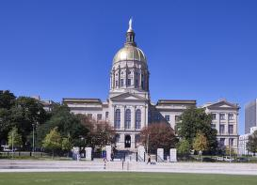
Entrance into the Capitol
﻿
Id's- All adults age 18 and older must show a Photo ID upon entering the Capitol
Metal Detectors- Visitors must enter the Capitol through a metal detector and an X-Ray machine will examine
hand-carried items
Items to leave at home- no weapons, including pocketknives
﻿are allowed.

Slide 9
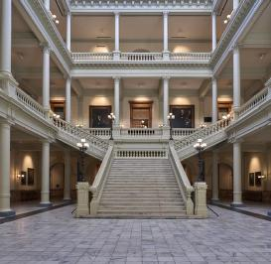
Legislative Visits
﻿
Find out who your state senator and representative are by going to www.pluralpolicy.com. Click here for more information.
Make an appointment prior to prevention day.
Prepare a community 1 pager
Prepare an elevator speech - click here for example
If in a group, choose a leader
Choose one person to share a personal story

Slide 10
You then stand in line in order to give your form to a secretary whose desk is by the Chamber door. The secretary will give your form to a volunteer student page, making sure the page and you know what each other look like so the page can find you when they come back out.
The page will then carry your message to your legislator in the Senate or House Chamber if they are in the Chamber and at their assigned desk.
The page will then come back to the “Ropes” in front of the Senate or House Chamber looking for you to tell you if your Senator or Representative will be able to come to meet you at the “Ropes”.
If they can meet you, you then need to keep looking very carefully for your Senator or Representative to come to the “Ropes”, especially if they don’t know what you look like. Sometimes this takes a while.
Meet with your Legislator “at the Ropes”
If you didn’t schedule a meeting with your senator and representative you can still meet them at the “ropes”.
Note: You will need to know what your Senator or Representative look like by googling their name and then ga.gov
You can still meet with your Senator and Representative by going to the 3rd floor of the Capitol.
The Senate Chamber is one side of the Capitol building and the House of Representative Chamber is on the other side of the Capitol building.
There are small stands on the Senate side and on the House side where you can obtain a small form (usually yellow) that you complete, writing in your name and what legislator you want to meet with.

Slide 11
Youth Groups
At registration / Check-in, only one adult advisor will check-in the group and enter the number of youth and adult advisors attending the event.
Buses will be able to drop off students at the entrance of the Freight Depot and then go park.
Try to schedule a visit with your legislator prior to prevention day if possible.
Let your Legislator know you will be coming- they may be available for a group photo.

Slide 12
Q & A
What questions do you have?

